Slide 1
Learning by Exploration
Qingyun Wu, Huazheng Wang, Hongning Wang
Department of Computer Science
University of Virginia

Slide 2
Outline of this tutorial
Motivation
Classical exploration strategies
Efficient exploration in complicated real-world environments
Exploration in non-stationary environments
Ethical considerations of exploration
Conclusion & future directions

Slide 3
Exploration in non-stationary environments
Action
Exploitation + Exploration
Stationary assumption is commonly used
The learner is usually facing a non-stationary environment ☹
Reward
Expected Reward
Time
Non-stationary environments

Slide 4
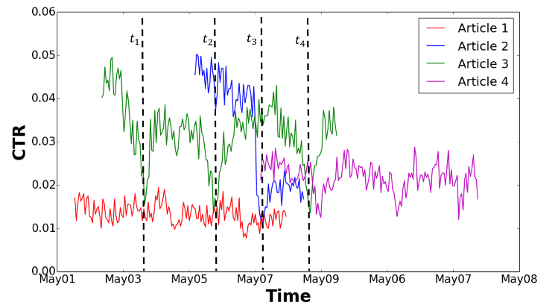
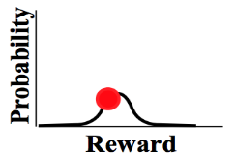
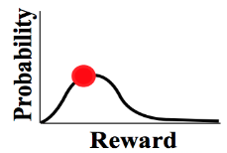
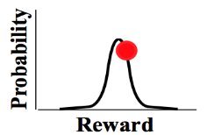
Problem formulation
(stochastic) Multi-arm bandit
Non-stationary
…
…
Reward distribution
…
Real-time click-through-rate of 4 news articles collected from Yahoo user click log dataset
Actions
I need to be adaptive about potential changes in the environment
☹
Agent/learner/policy
Reward
☺
Regret
History is no longer helpful and may even be misleading in the player’s decision-making
Non-stationary environments
Time

Slide 5
Problem formulation
Different types of non-stationary environments
Piecewise stationary environments
Gradually changing environments
Main focus of this tutorial
More difficult and less studied.
Expected Reward
Expected Reward
Time
Time
Non-stationary environments

Slide 6
Challenges
Changes (when and how) are unknown to the learner
(otherwise we can just restart the learner)
Online learning setting and bandit feedback: incomplete knowledge
(change detection in the offline batch setting has been extensively studied in statistics and control theory ^{[BN93]} )
Non-stationary environments

Slide 7
Approaches
Passively adaptive approaches
Key idea: design a proper mechanism to forget old observations
Assumption: old observations are less relevant
Actively adaptive approaches
Key idea: actively detect potential changes in the environment during online decision making
Assumption: abrupt changes, i.e., piece-wise stationary environment
Non-stationary environments
Notes:
Actively adaptive: Instead of blindly discount or forget past observations, the bandit learning algorithm should actively detect the change points (assuming abrupt change points)

Slide 8
Passively adaptive approaches
Discounted UCB and Sliding window UCB [GM08]
Discount the old observations
Only utilize the most recent $τ$ observations
Weighted linear bandit [RVC19]
Discounted-UCB in the linear contextual bandit setting
Non-stationary environments

Slide 9
Passively adaptive approaches
Pros
Simple: easy to implement and have almost no computation overhead
Have provable theoretical guarantee in piece-wise non-stationary environment and environments with slow changes
Cons
Passive: always assuming old observations are less relevant
Not practical: very sensitive to hyper-parameters discount factor, sliding-window size
Non-stationary environments

Slide 10
Actively adaptive approaches
General framework
Statistics about the stationarity of the environment
Non-stationary environments

Slide 11
Non-stationarity detection with bandit feedback
Cumulative sum control chart (CUSUM) based detection
AdTS [HMB15], CD-UCB [LLS18]
Generalized likelihood ratio test
GLR-kl-UCB [BK19]
Online reward mean-shift detection
WMD-UCB1 [YM09], M-UCB [CWKX19]
Confidence bound based detection
dLinUCB [WIW18], DenBand [WWLW19]
Other
Ada-ILTCB, Ada-greedy [LWAL18], Ada-ILTCB^{[+]} [CLLW19]
…
Non-stationary environments

Slide 12
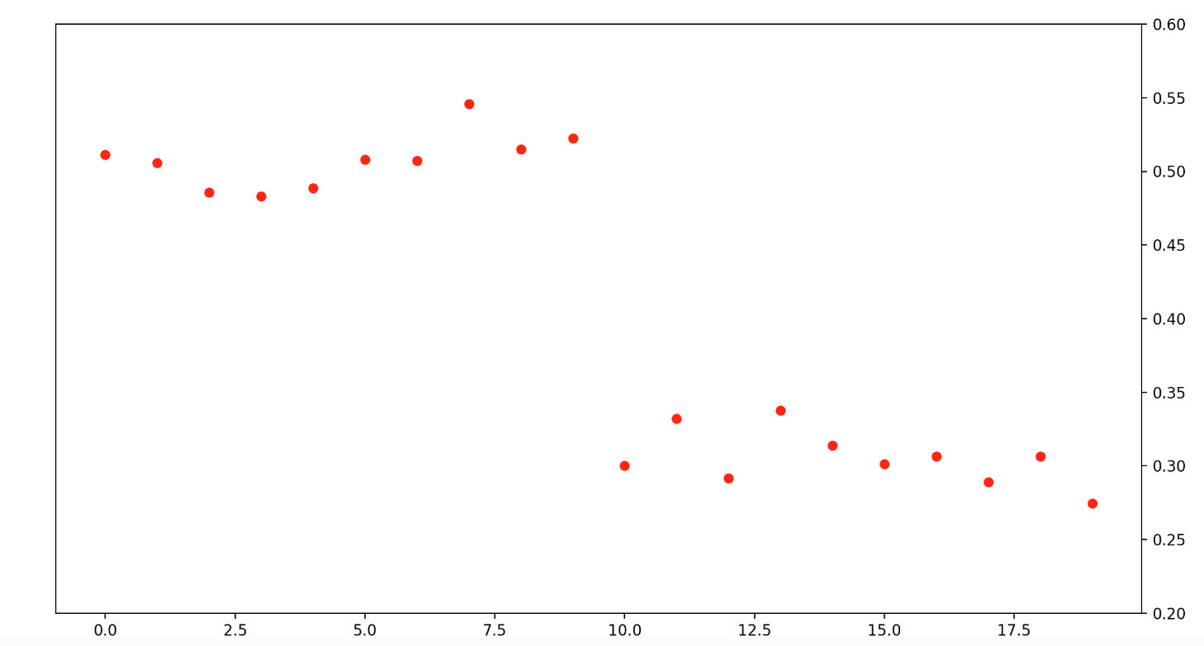
CUSUM-based online change detection
CUSUM in the offline setting
Cumulative sum of log-likelihood ratio before and after change points:
Observed reward
0
Non-stationary environments

Slide 13
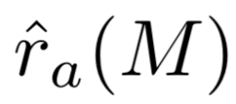
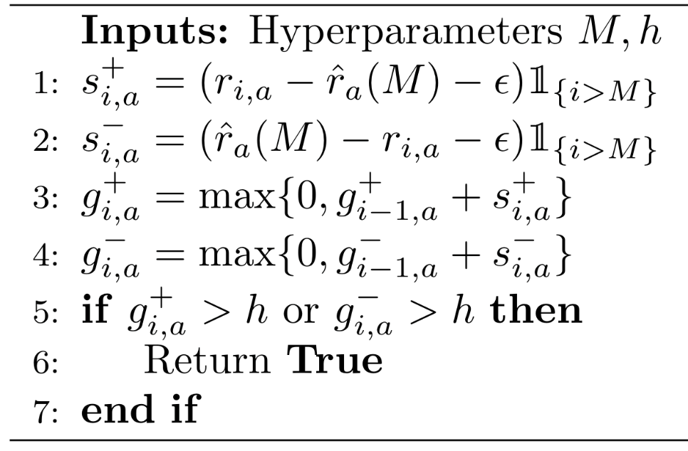
CUSUM-based online change detection
Tailored CUSUM in the Bernoulli bandit setting
CUSUM in CD-UCB [LLS18]
Intuition:
Each arm needs to have at least M observations
Requirement on the minimum magnitude of changes on the reward
has negative mean drift before the change point and positive after the change point
Assumptions:
Piecewise stationary with detectability assumption
Bernoulli bandit
Detection threshold
Local restart: restart the related statistics for the changed arms
Non-stationary environments

Slide 14
Generalized likelihood ratio test based online change detection
CUSUM requires the pre-change and post-change environment parameters to be known to get the log-likelihood.
Unknown pre-change and/or post-change parameters -> Generalized Likelihood Ratio Test (GLRT)
GLRT with Bernoulli reward -> GLR-klUCB [BK19]
GLRT can achieve asymptotically optimal detection delay with sub-Gaussian reward assumption [Mai19]
Non-stationary environments

Slide 15
Online mean-shift detection
Monitored-UCB [CWKX19]
Compare running sample means over a sliding window
>b
Global restart: once a change is detected, restart the related statistics for all the arms
Need to periodically perform uniform arm selection (uniform exploration)
to ensure sufficient data can be gathered for all arms to perform CD
Arm selection between detected change points (except for the uniform exploration iterations): UCB1
Non-stationary environments

Slide 16
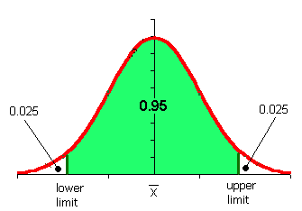
CB based online change detection
Utilizing the reward estimation confidence bound [WIW18, WWLW19]
If the environment is stationary, the reward prediction residual should be within a confidence bound with high probability,
Predicted reward of bandit model m
Observed reward
Confidence bound of reward estimation
We can bound this to further exclude this possibility!
Unexpected outcome is caused by,
Something wrong in the observed reward: large noise
Something wrong in the predicted reward: the model is incorrect
Non-stationary environments

Slide 17
CB based online change detection
Prediction badness at interaction $i$:
Similar to the goodness of fit concept in chi-squared test
Badness of model m over a sliding time window:
a sliding time window to collect badness observations
Detection threshold:
Bad enough:
Good enough:
Change detected.
(abandon learner m)
When no learner is good enough, will also report a change.
(but do not abandon learner m)
Non-stationary environments

Slide 18
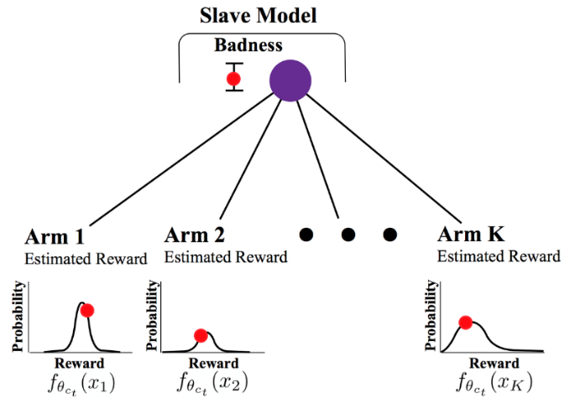
CB based online change detection
dLinUCB [WNW18]
Adaptively creates new learners
Monitors the prediction quality of each learner
Selects a learner according to each learner’s ‘badness’
.
.
…
badness
badness
Badness estimation update
Reward estimation update
…
…
Non-stationary environments

Slide 19
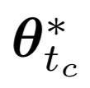
Detection of context-dependent changes
Change-sensitive arms
Expected Reward
Change-invariant arms
Time
Learner 1
Learner 2
DenBand [WWLW19]
Reuse the experiences learnt in old models for change-invariant arms
Reward estimation on change-invariant arms
Save unnecessarily exploration
…
…
Non-stationary environments

Slide 20
Empirical evaluations
Simulation-based evaluation
Simulate the non-stationary environment
Evaluation on real-world datasets
On real-world datasets that have non-stationarity
(e.g. Yahoo! Front Page Today Module User Click Log Dataset)
Semi-simulation-based evaluation
Real-world datasets (that do not have non-stationarity) + simulated changes
Non-stationary environments

Slide 21
Theoretical guarantee
Total number of changes up to time T in a
piecewise stationary environment
Total variation of reward distributions up to time T
Analyzed their solutions with different notations of regret in different non-stationary environments: interval regret, switching regret, dynamic regret
Non-stationary environments

Slide 22
Open questions
Can we re-use related historical observations (e.g., recurring environment, or context-dependent changes) and what’s the benefit of it ?
How to handle gradually changing environment
Reinforcement learning in non-stationary environments
Non-stationary environments

Slide 23
References IV
[BN93] Basseville, M., & Nikiforov, I. V. (1993). Detection of abrupt changes: theory and application (Vol. 104). Englewood Cliffs: prentice Hall.
[GM08] Garivier, A., & Moulines, E. (2008). On upper-confidence bound policies for non-stationary bandit problems. arXiv preprint arXiv:0805.3415.
[RVC19] Russac, Y., Vernade, C., & Cappé, O. (2019). Weighted linear bandits for non-stationary environments. In Advances in Neural Information Processing Systems (pp. 12040-12049).
[YM09] Yu, J. Y., & Mannor, S. (2009, June). Piecewise-stationary bandit problems with side observations. In Proceedings of the 26th annual international conference on machine learning (pp. 1177-1184).
[HMB15] Hariri, N., Mobasher, B., & Burke, R. (2015, June). Adapting to user preference changes in interactive recommendation. In Twenty-Fourth International Joint Conference on Artificial Intelligence.
[WNW18] Wu, Q., Iyer, N., & Wang, H. (2018, June). Learning contextual bandits in a non-stationary environment. In The 41st International ACM SIGIR Conference on Research & Development in Information Retrieval (pp. 495-504).
[LWAL18] Luo, H., Wei, C. Y., Agarwal, A., & Langford, J. (2018, July). Efficient contextual bandits in non-stationary worlds. In Conference On Learning Theory (pp. 1739-1776).
[CWKX19] Cao, Y., Wen, Z., Kveton, B., & Xie, Y. (2019, April). Nearly optimal adaptive procedure with change detection for piecewise-stationary bandit. In The 22nd International Conference on Artificial Intelligence and Statistics (pp. 418-427).
[LLS18] Liu, Fang, Joohyun Lee, and Ness Shroff. “A change-detection based framework for piecewise-stationary multi-armed bandit problem.” Thirty-Second AAAI Conference on Artificial Intelligence. 2018.
[WWLW19] Wu, Q., Wang, H., Li, Y., & Wang, H. (2019, May). Dynamic Ensemble of Contextual Bandits to Satisfy Users' Changing Interests. In The World Wide Web Conference (pp. 2080-2090).
[CLLW19] Chen, Y., Lee, C. W., Luo, H., & Wei, C. Y. (2019). A new algorithm for non-stationary contextual bandits: Efficient, optimal, and parameter-free. arXiv preprint arXiv:1902.00980.
[BK19] Besson, L., & Kaufmann, E. (2019). The generalized likelihood ratio test meets klucb: an improved algorithm for piece-wise non-stationary bandits. arXiv preprint arXiv:1902.01575.
[Mai19] Maillard, O. A. (2019). Sequential change-point detection: Laplace concentration of scan statistics and non-asymptotic delay bounds.

